Slide 1

Group T32 Appointment Scheduling System
Group Members:
1. Trisha Conde
2. Prishita Ribadia
3. Adam Vandyke
4. Ho Ba Hoang Nguyen
5. Thi Thuy Nguyen
Presenters: Adam Vandyke

Slide 2
Group T32 Appointment Scheduling System
Presentation Agenda:
1. Project Description
2. Project Requirements
3. Project Progress
4. Future Plans
5. Q&A Session
Presenters: Adam Vandyke

Slide 3
Group T32 Appointment Scheduling System
Project Description:
About Vandyke Law:
This project is created in partnership with Vandyke Law. Vandyke Law is a Law Firm based in southern Ontario its services provide legal representation of a high standard in Southern Ontario and prides itself on no costs to its clients until cases are resolved or judgement is obtained. They have experience in a wide range of cases whether it is a motor vehicle accident, catastrophic injury, slip and fall incident, disability insurance denial or WSIB claim.
Presenters: Adam Vandyke

Slide 4
Group T32 Appointment Scheduling System
Project Description:
About the project:
This project is to recreate a web application that will help clients to schedule appointments by clients online thereby reducing the workload for the employees working at Vandyke Law. By doing so our application will increase the efficiency of workplace operations by organizing consultations and appointments into a user-friendly system leading towards making the firm a paperless workspace.
Presenters: Adam Vandyke

Slide 5
Group T32 Appointment Scheduling System
Project Requirements (Old):
Design Requirements | Software Requirements
Front-End | .NET Framework, ASP.NET, HTML, CSS, JS
Back-End | C#
Database | SQL Server
Presenters: Prishita Ribadia

Slide 6
Group T32 Appointment Scheduling System
Project Requirements (New):
Design Requirements | Software Requirements
Front-End | HTML, Thymeleaf, Spring Boot
Back-End | Java
Database | H2 Database
Presenters: Prishita Ribadia

Slide 7

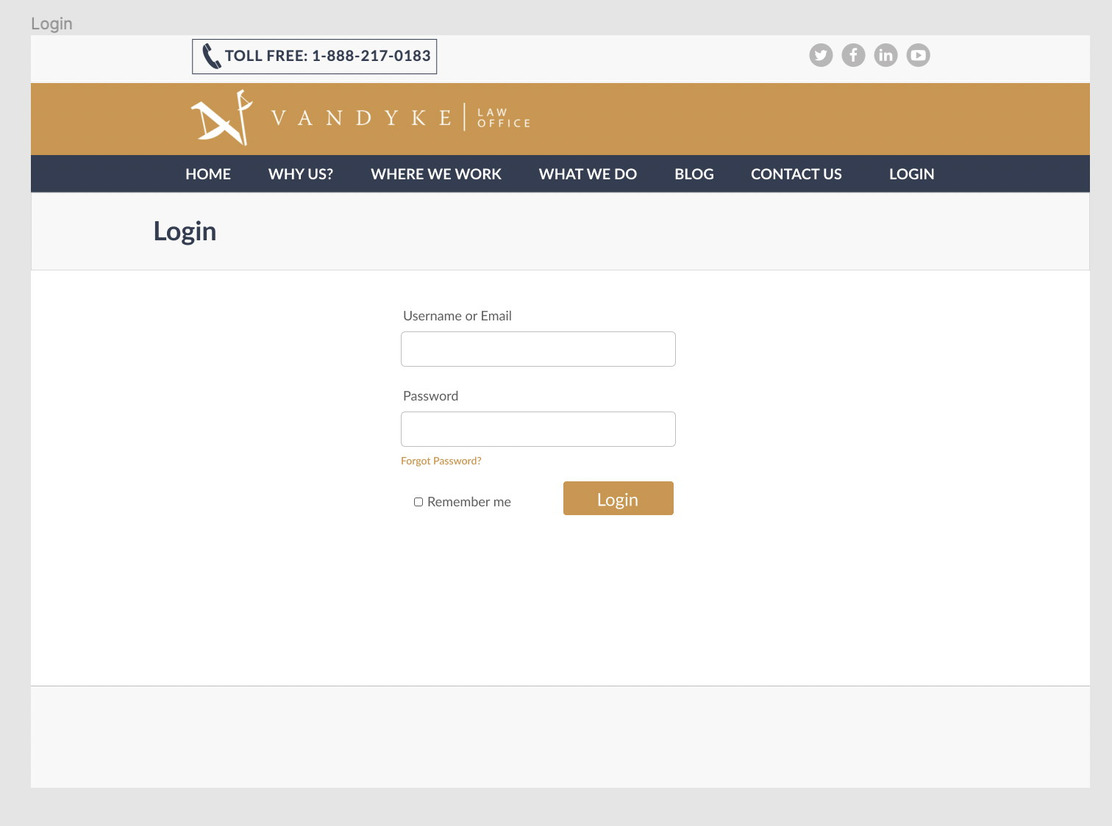
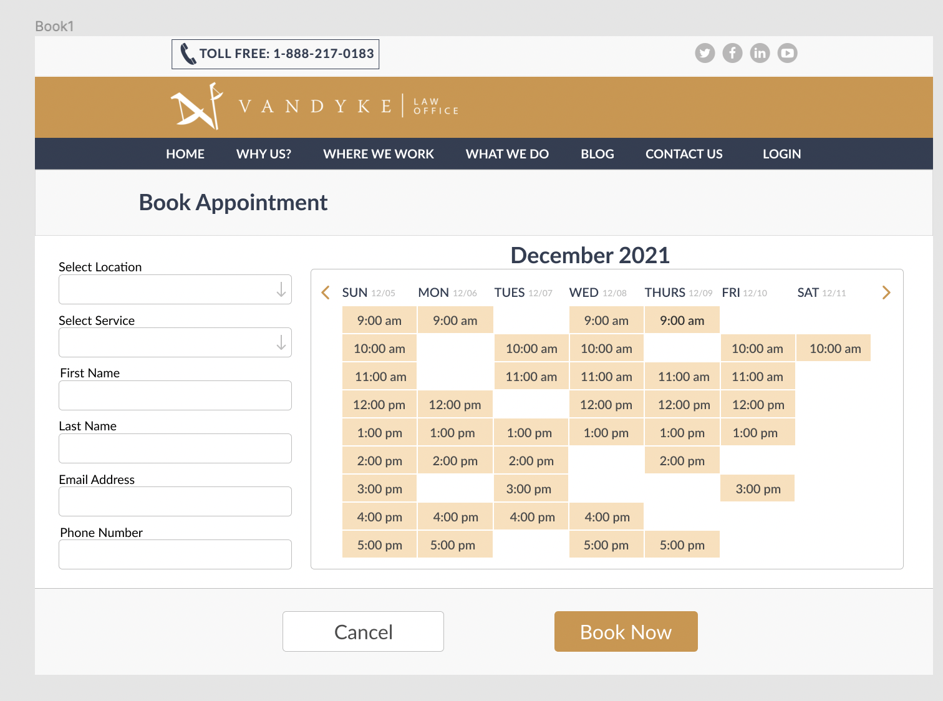
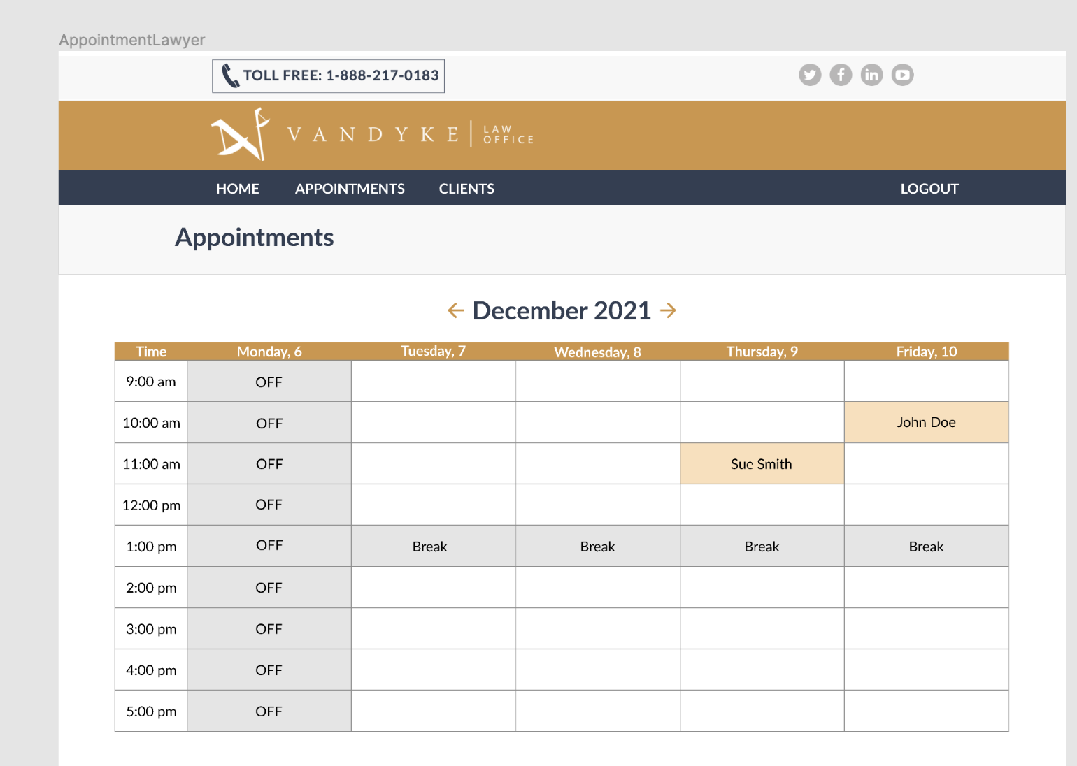
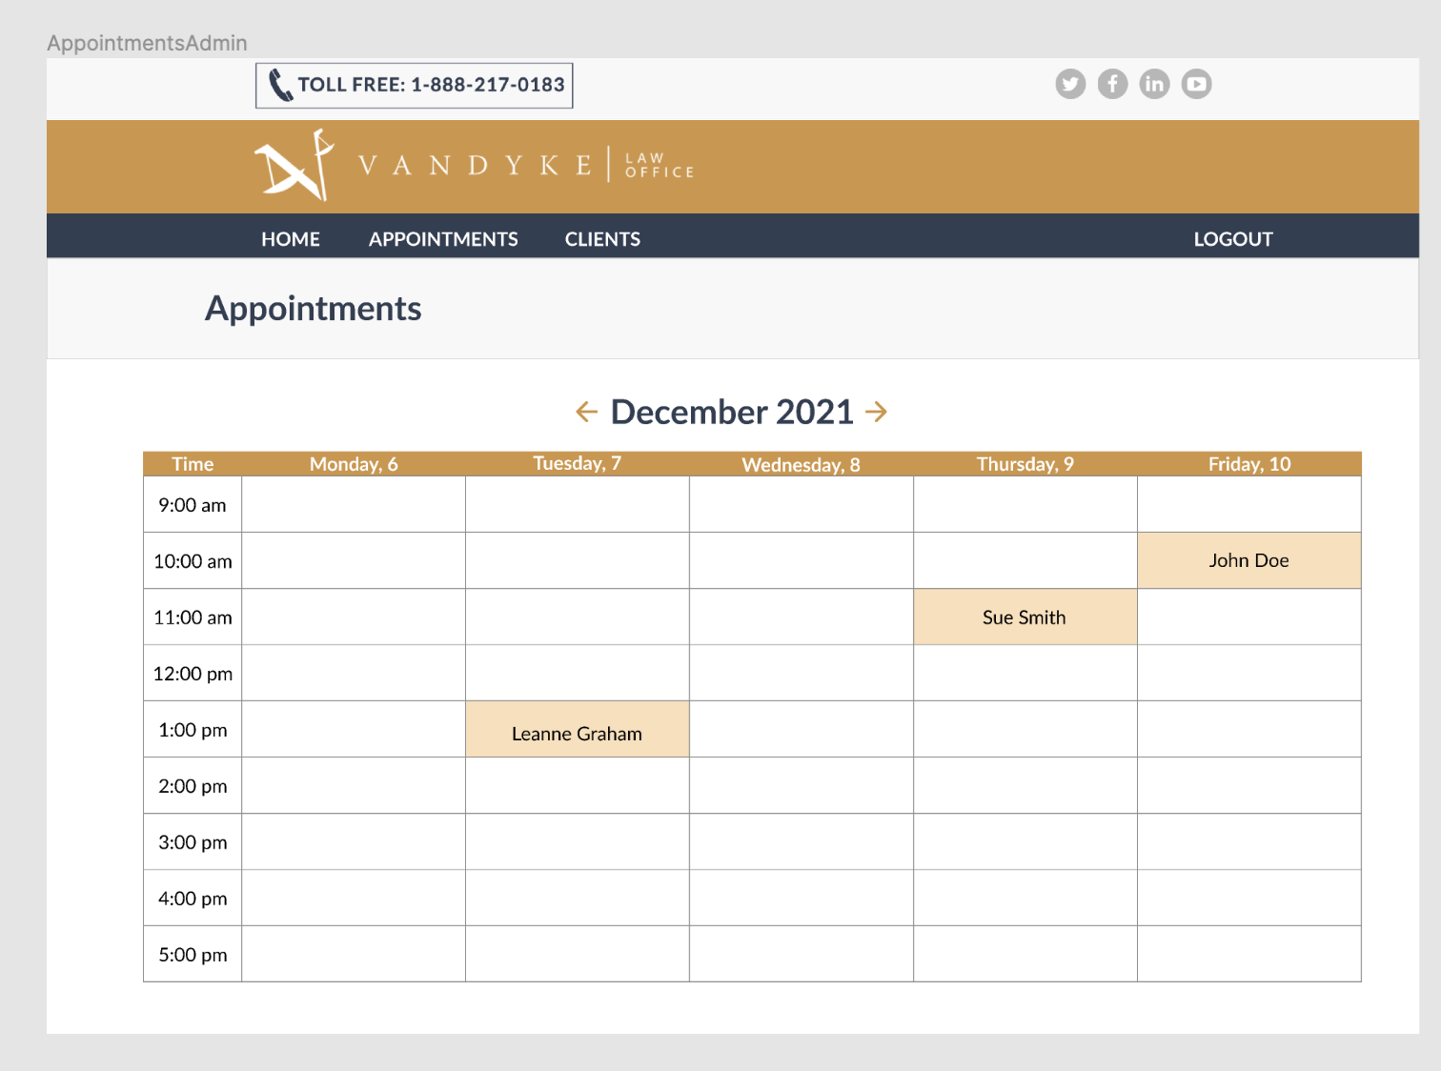
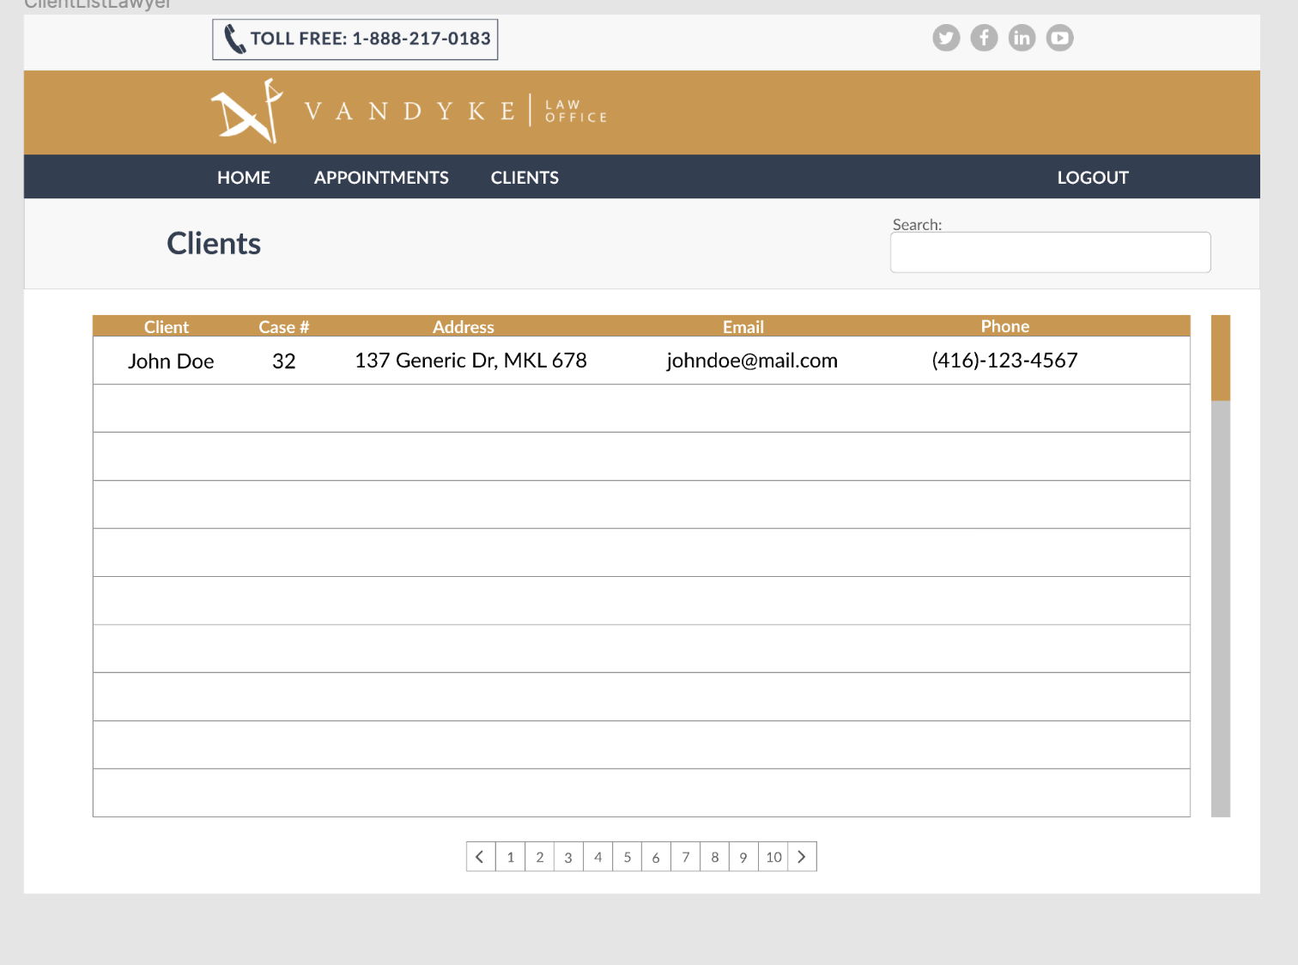
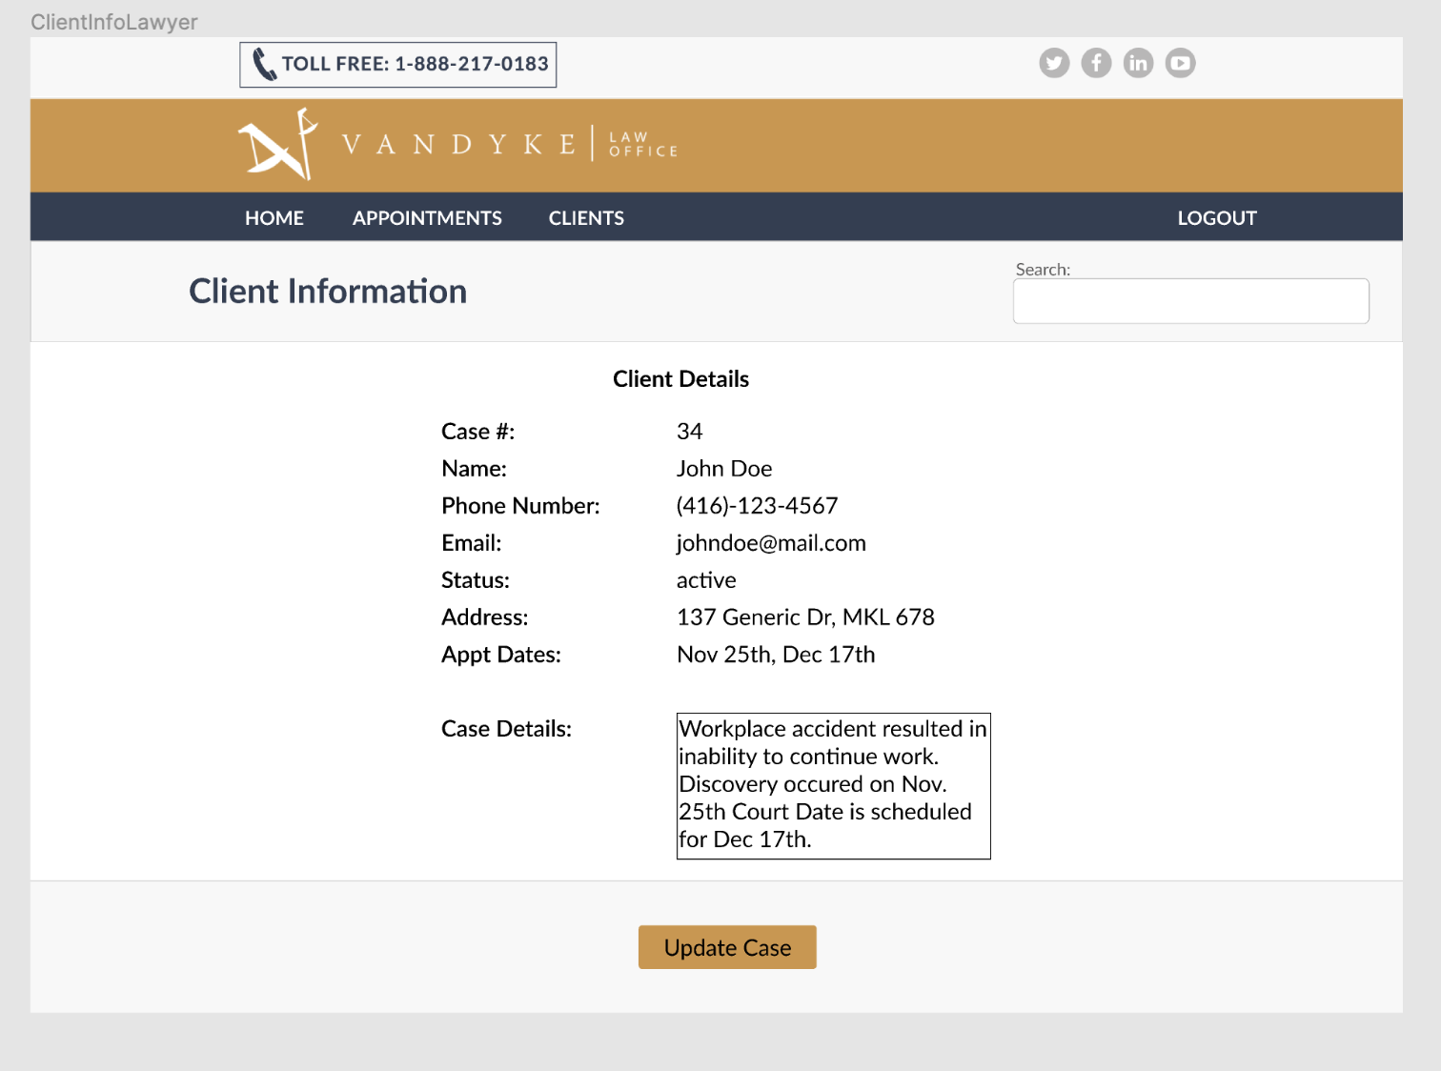
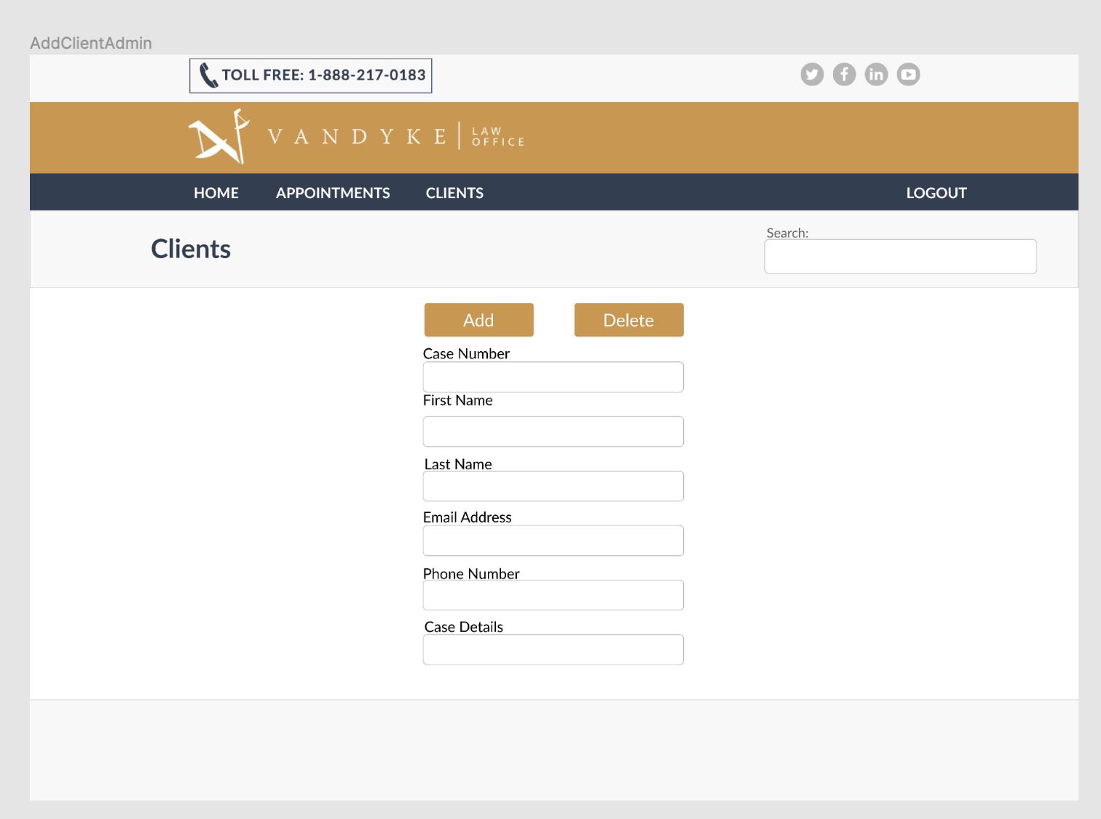
Group T32 Appointment Scheduling System
Project Progress:
Achievements
Front-End:
- Daily updates for Github Repo
- Designs for Client-Side interface
- Updates for Admin
- Lawyer interface designs
2 . Back-End & Database:
- Planning
- Assigned the work
- Daily review and updates
Presenters: Thi Thuy Nguyen, Trisha Conde

Slide 8
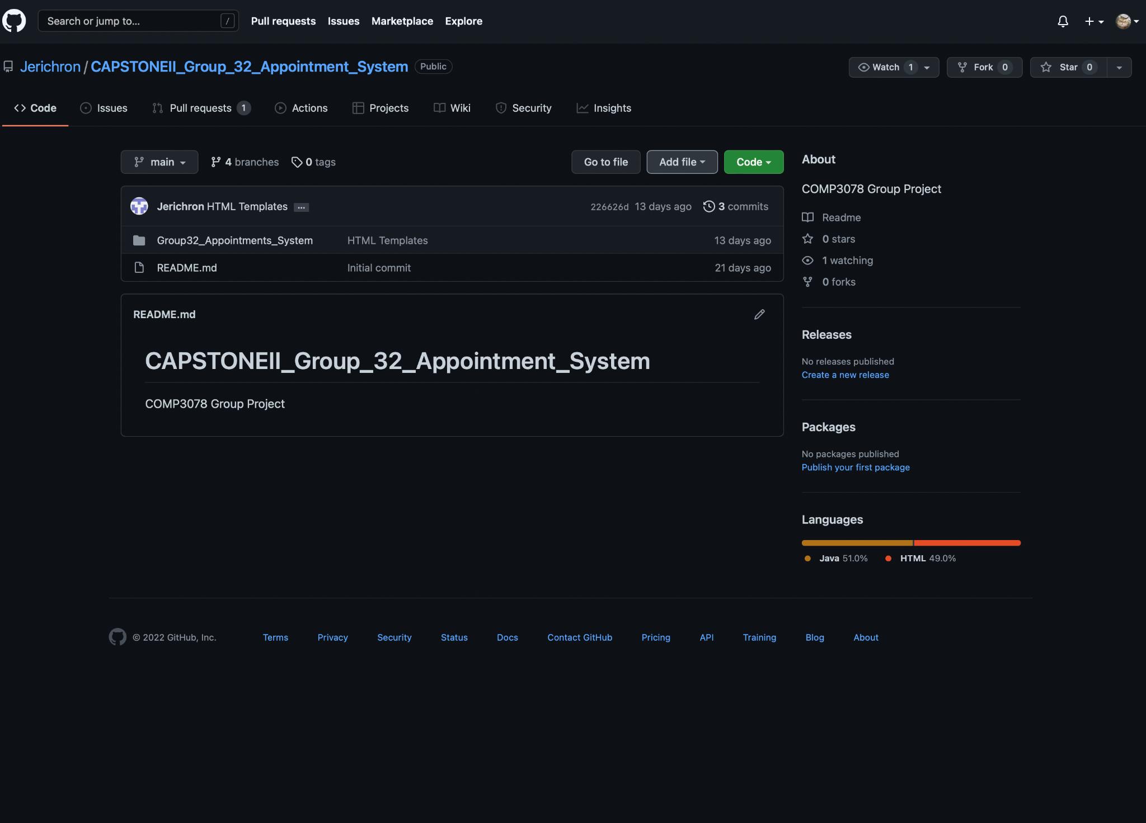
Group T32 Appointment Scheduling System
Project Progress:
Demo
Source code
Github link:
https://github.com/Jerichron/
CAPSTONEII_Group_32_Appointment_System
Presenters: Thi Thuy Nguyen, Trisha Conde

Slide 9
Group T32 Appointment Scheduling System
Future Plans:
Database Implementation.
In order to fulfill the intent of our application a functioning database is required to store and manage appointment details.
It is also required to store admin details and information.
Front End.
Basic Tweaking and updates to the HTML templates otherwise Front End should be finalized within the next stages.
Presenters: Hoang

Slide 10
Group T32 Appointment Scheduling System
Q&A Session:
Thank you for watching!
Presenters: Adam Vandyke, Thi Thuy Nguyen, Prishita Ribadia, Trisha Conde, Hoang

